Slide 1



CORPORATE PORTFOLIO
MODERN HOUSEHOLD
ELECTRONICS
Company Presentation of INTER-SAT LTD and the licensed TESLA brand portfolio.

Slide 2

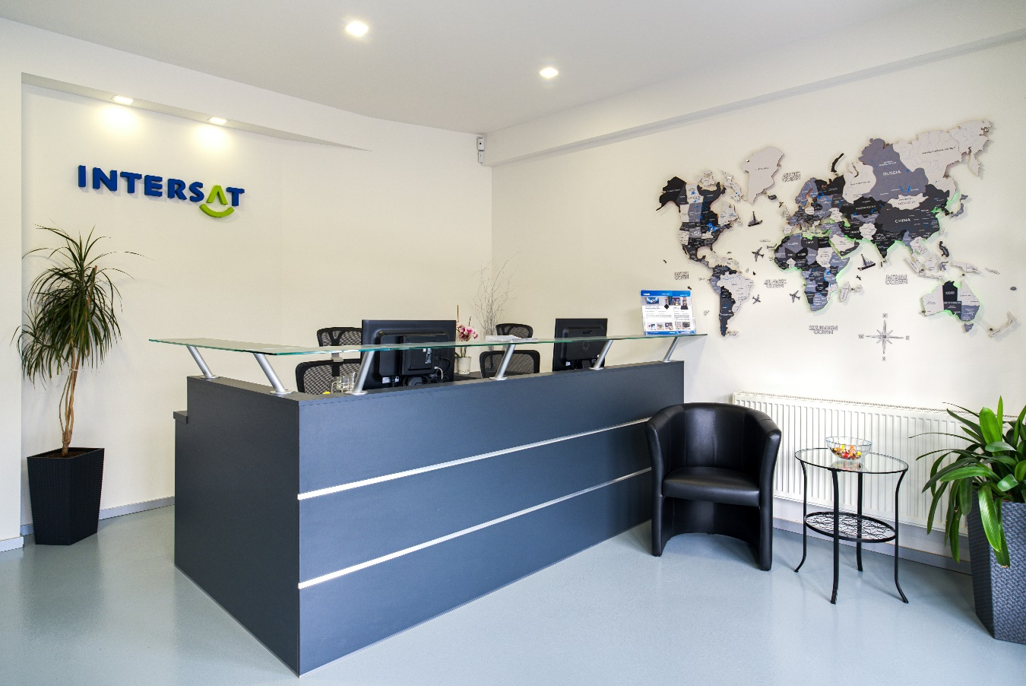
ABOUT INTER-SAT LTD
Leading Wholesale Distributor & Developer
Founded in 1996, INTER-SAT has successfully operated as a dynamic trading enterprise focusing on wholesale satellite, antenna, and television equipment distribution.
EU-Wide Expansion: Headquartered in Czechia with strong activities expanding extensively across the European Union.
R&D Excellence: Established a dedicated research & development center in 2010 managing multiple proprietary private labels.
Product Portfolio: Primary supplier of smart home systems, security, household appliances, and telecommunication hardware.

Slide 3


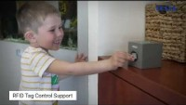
INTRODUCING THE TESLA BRAND
A Traditional Czech Household Icon
TESLA is a deeply rooted Czech trademark celebrated for consumer and industrial electronics since the mid-20th century.
In 2017, INTER-SAT LTD successfully acquired the official brand license from TESLA a.s. to drive modern consumer innovation.
LICENSED PORTFOLIO SCOPE
Robotic Vacuum Presure Cookers Air Fryers Vacuum cleaners Audio&Video Smart home Secure Power chargers Beauty&Care products

Slide 4





SERVICE & QUALITY ASSURANCE
We complement our product design with robust after-sales care and premium engineering guarantees.
Fast Support
CZ Service Center
Premium Care
Direct accessibility to professional technical helpdesks, offering rapid assistance and custom installations diagnostics.
A perfectly functioning centralized in-house service department keeping a complete volume of original spare parts always in stock.
Comprehensive "TESLA Premium Service" guarantees, providing up to a 3-year warranty option on selected premium models.
Product of the Year Winner
TESLA Quality Standard
Awarded by Heureka comparison engine repeatedly (2020-2023)
Compliance with rigorous EU manufacturing directives

Slide 5












RETAIL & DISTRIBUTION PARTNERS
TESLA products are distributed through key electronics retailers, local stores, and prominent e-commerce networks across Central Europe.

Slide 6

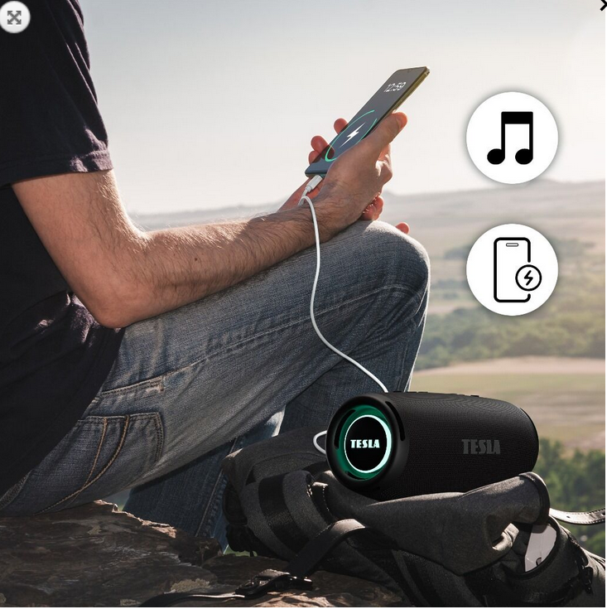

AUDIO PORTFOLIO
Audio & Lifestyle
High-fidelity acoustic hardware tuned for exceptional playback performance.
DAB+ Radios: Crystal-clear digital signal reception with color displays.
Soundbars: Slim home theater bars with subwoofer systems.
TWS Headphones: Modern Bluetooth earbuds with noise reduction.
Speakers: IPX-rated portable outdoor Bluetooth speakers.
PURE SOUND • MODERN DESIGNS

Slide 7
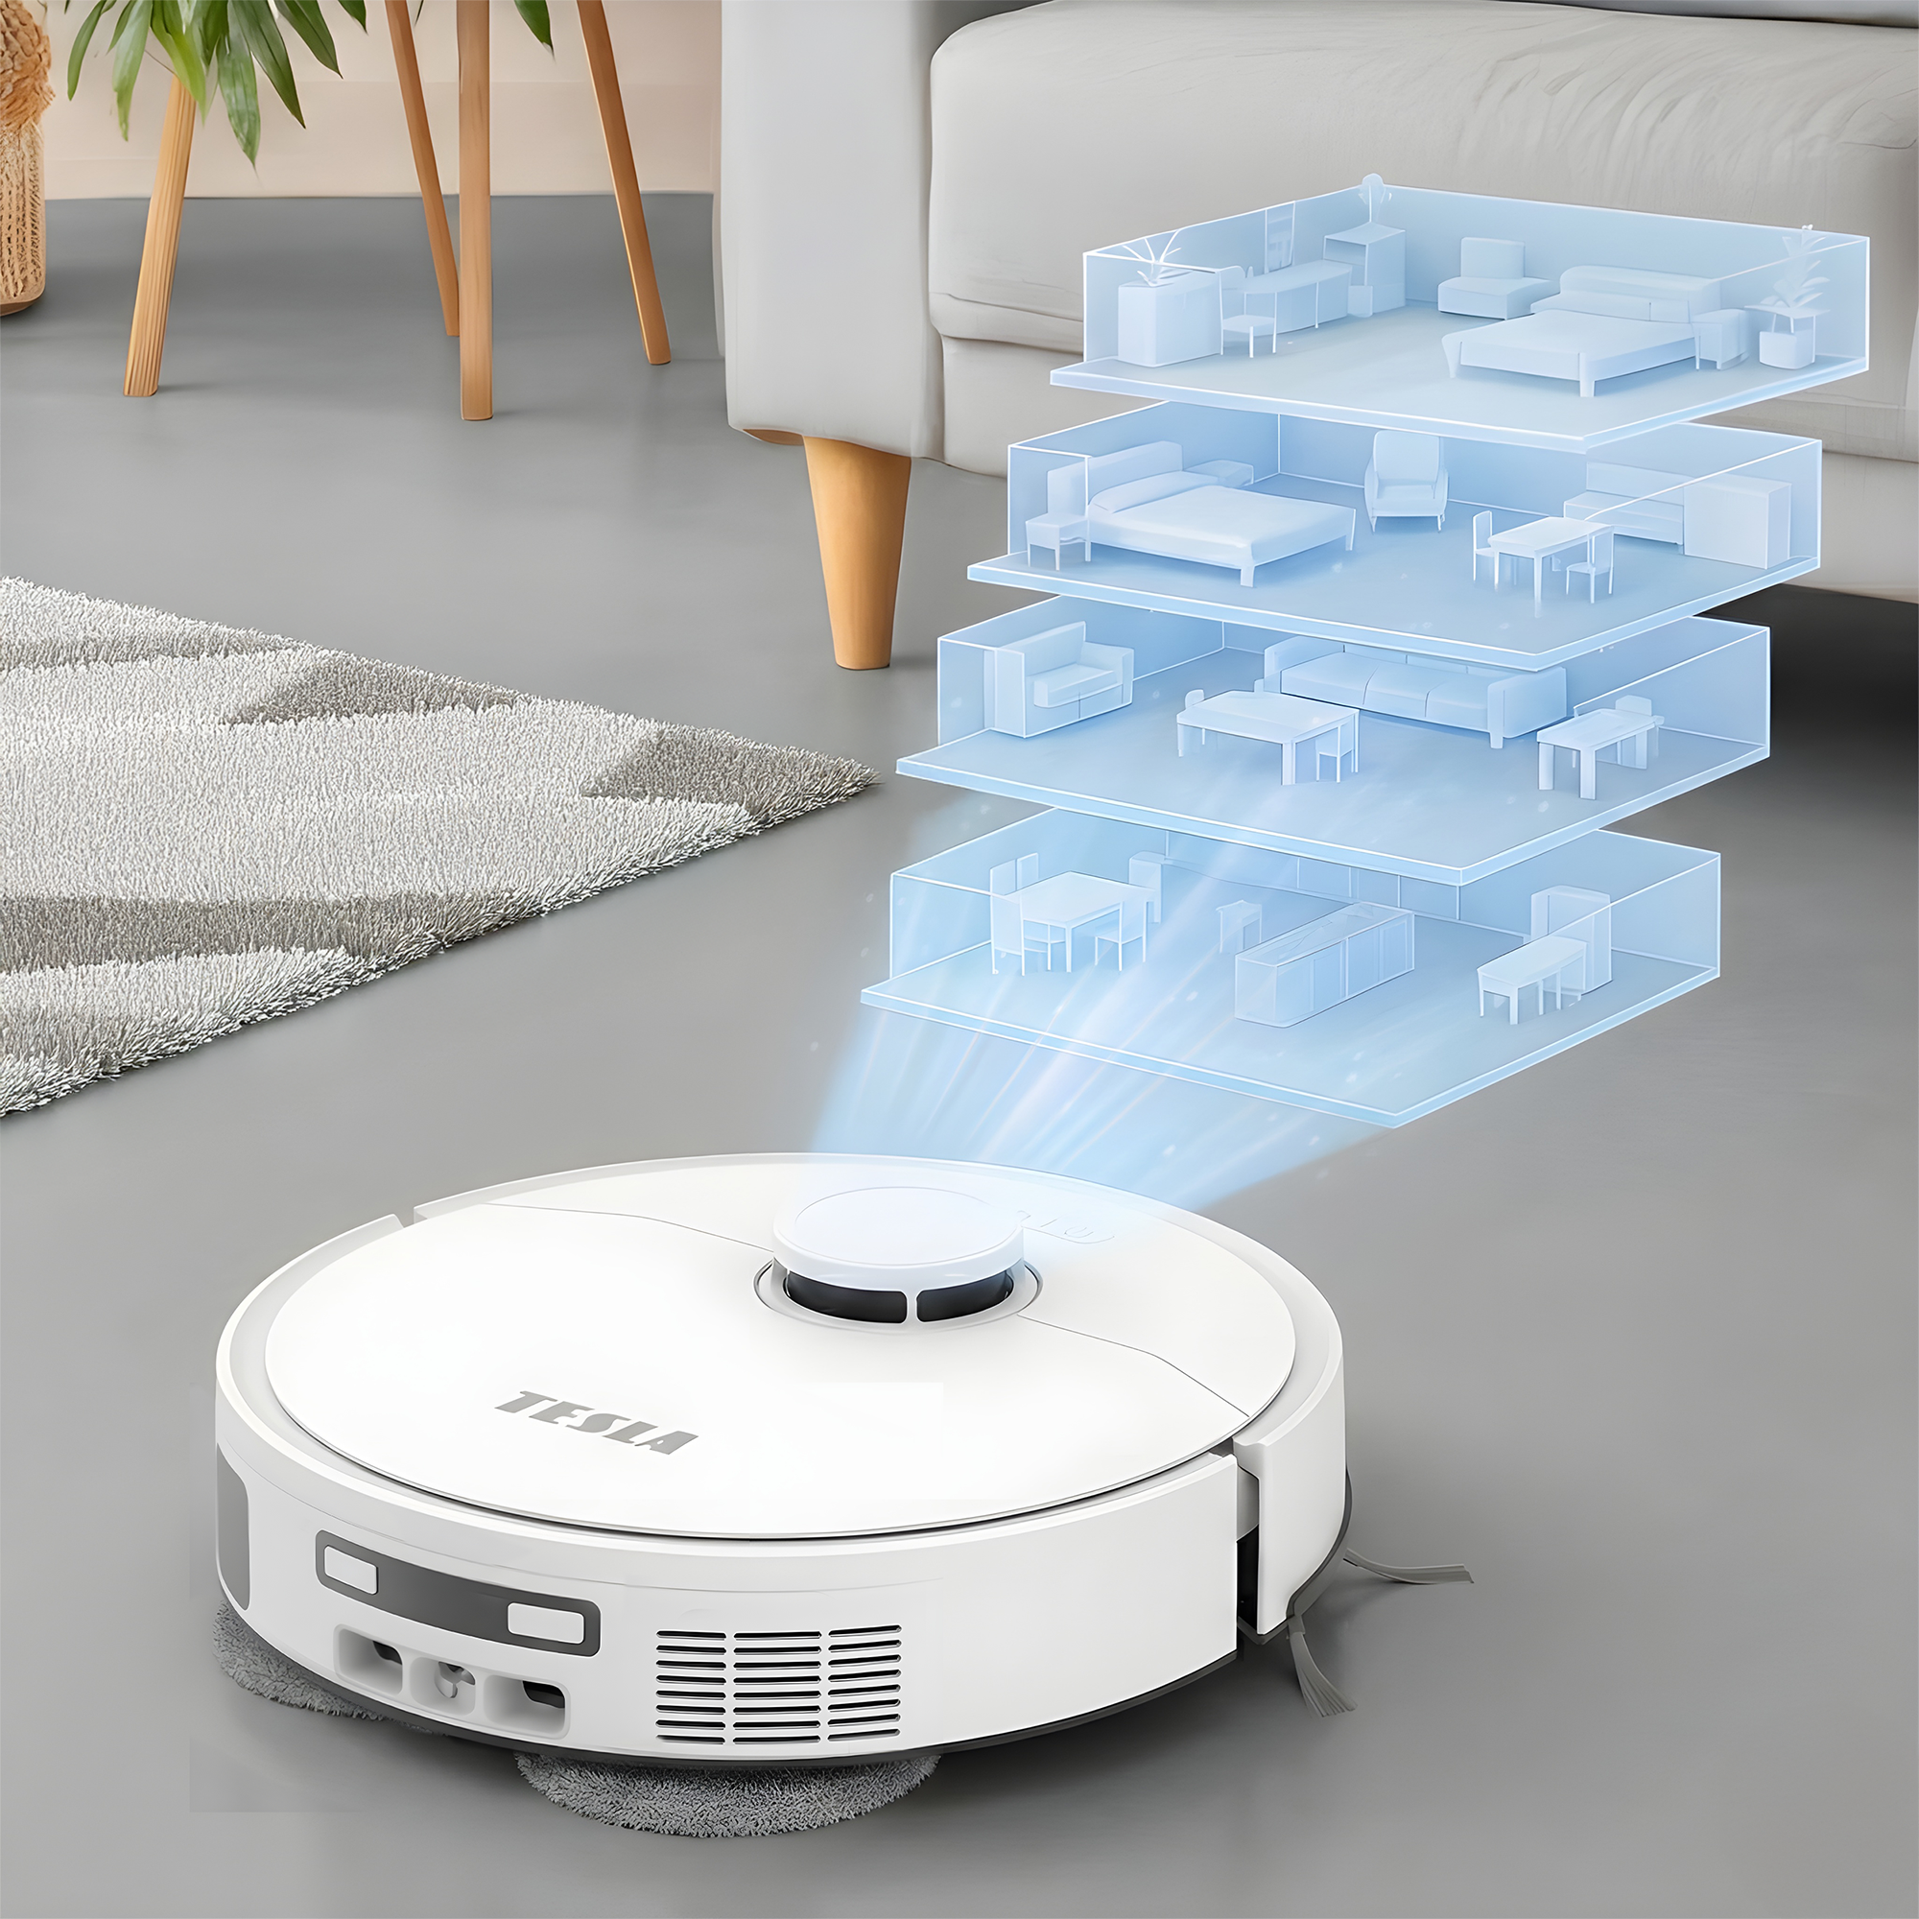
SMART CLEANING SOLUTIONS
Effortless Automated Home Maintenance
Our core cleaning category combines leading navigation programming, robust vacuum pressure, and smart app integration to reduce household labor.
Robotic Vacuums & Mops: Dual vacuuming and active wet mopping, and hands-free auto-empty docks.
Cordless Stick & Steam Cleaners: Stick and handheld vacuum cleaners with cyclonic filtration technology, charging docking station and multipurpose cleaner with steam function.
Specialized Maintenance Devices: Smart robotic window cleaners, handheld UV-C antibacterial vacuums, and clean pet grooming kits.

Slide 8
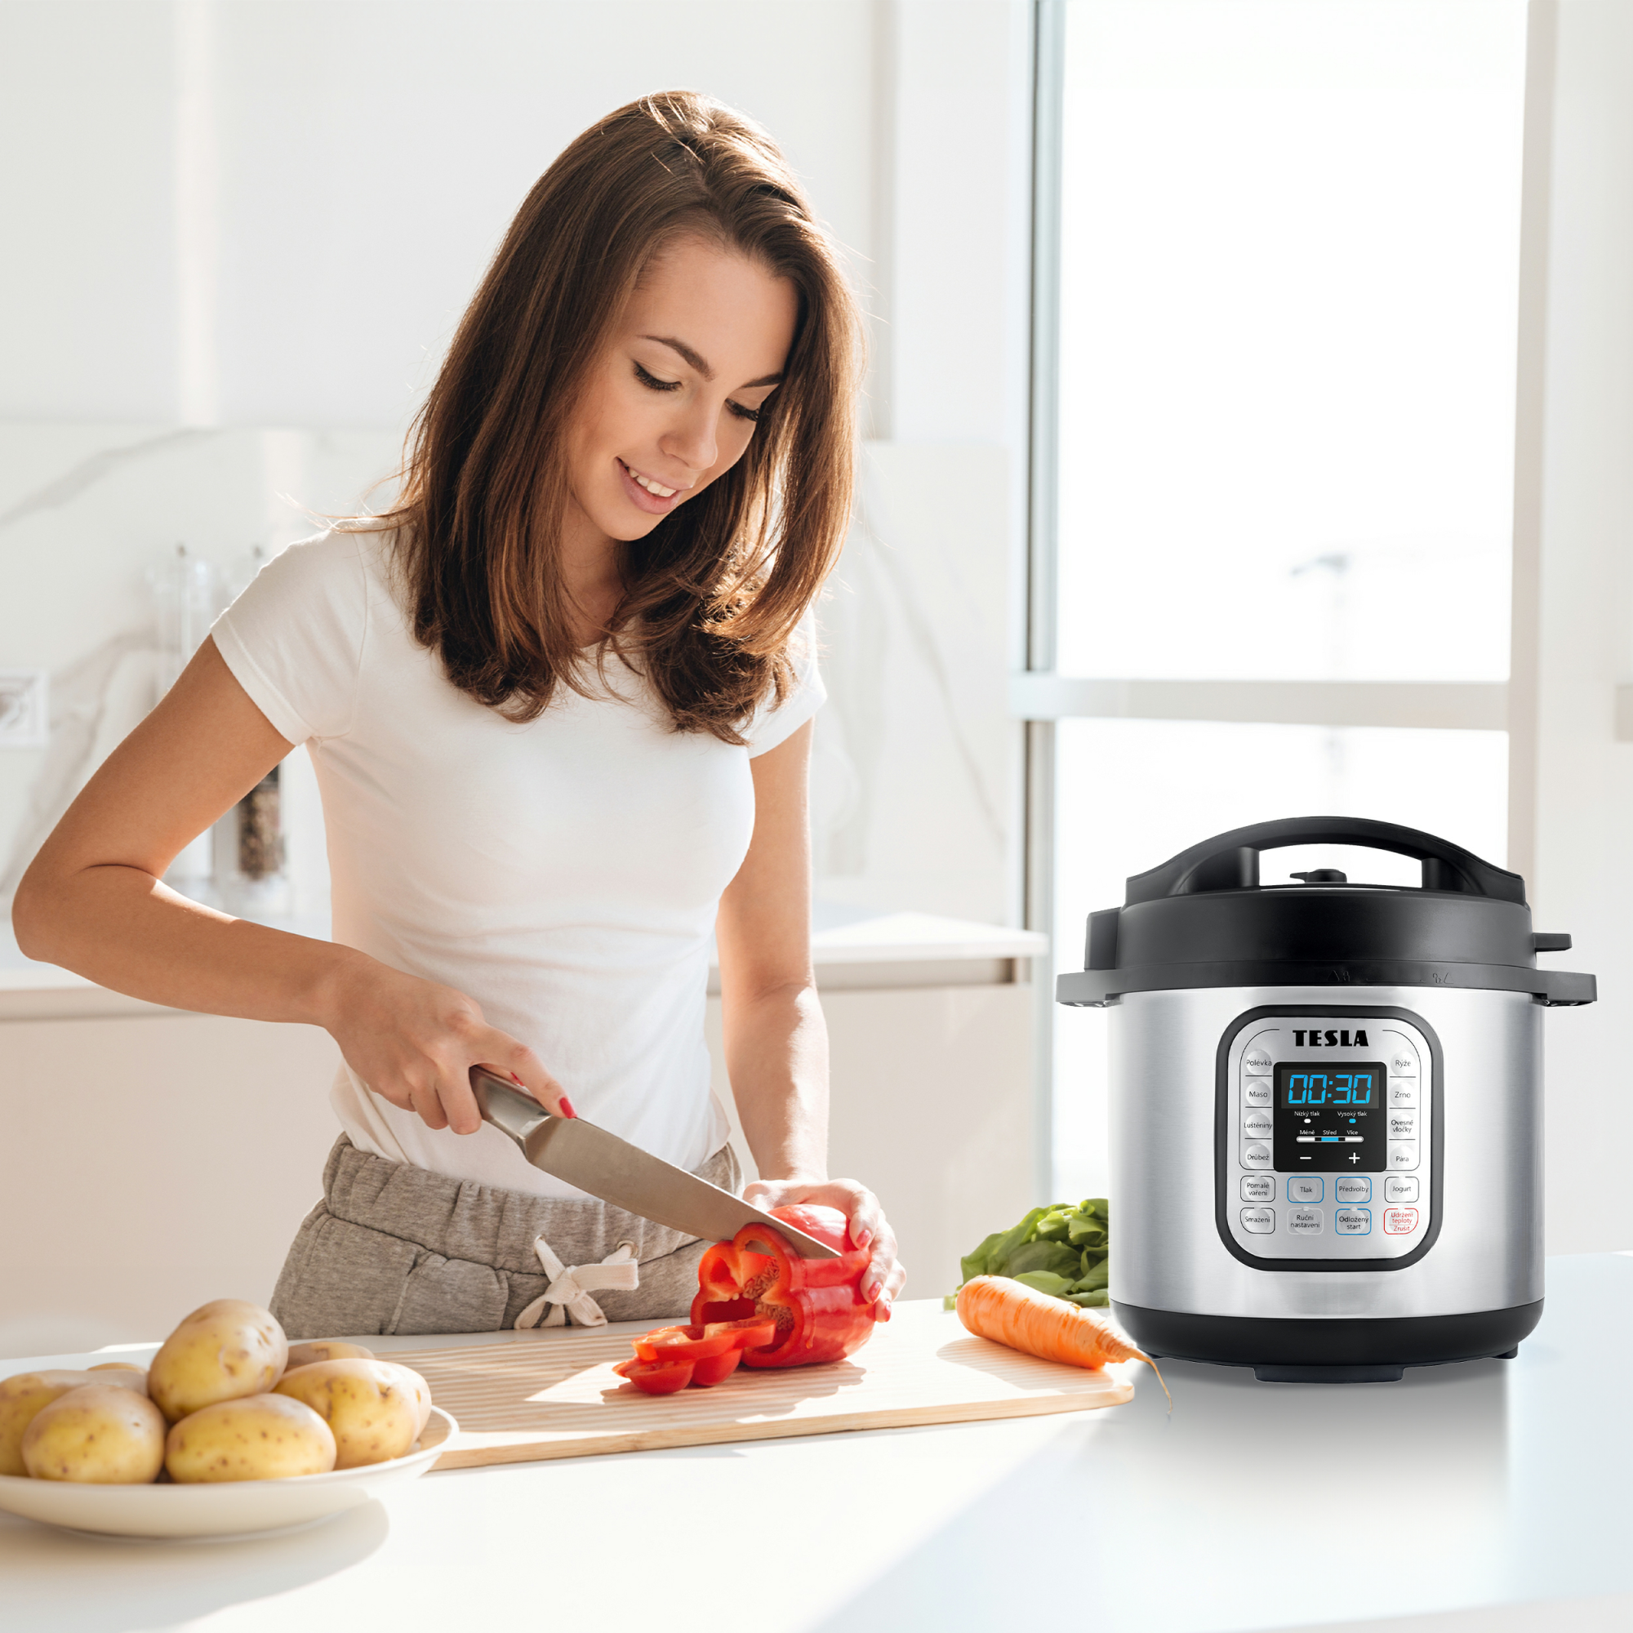
PRESSURE & MULTI-COOKERS
TESLA EliteCook K70 flagship
The ultimate kitchen champion. Awarded 5x Product of the Year (2020-2024) on Heureka.cz, the EliteCook series represents comfort, safety.
Multifunctional Performance: Combines pressure cooking, slow cooking, rice cooking, steaming, and yogurt preparation.
Smart Digital Cooking: Intuitive control menus, delay timer settings, and automatic "Keep Warm" capabilities.
Sous-vide Capability: Precision vacuum-packed low-temperature cooking for professional grade steaks.

Slide 9
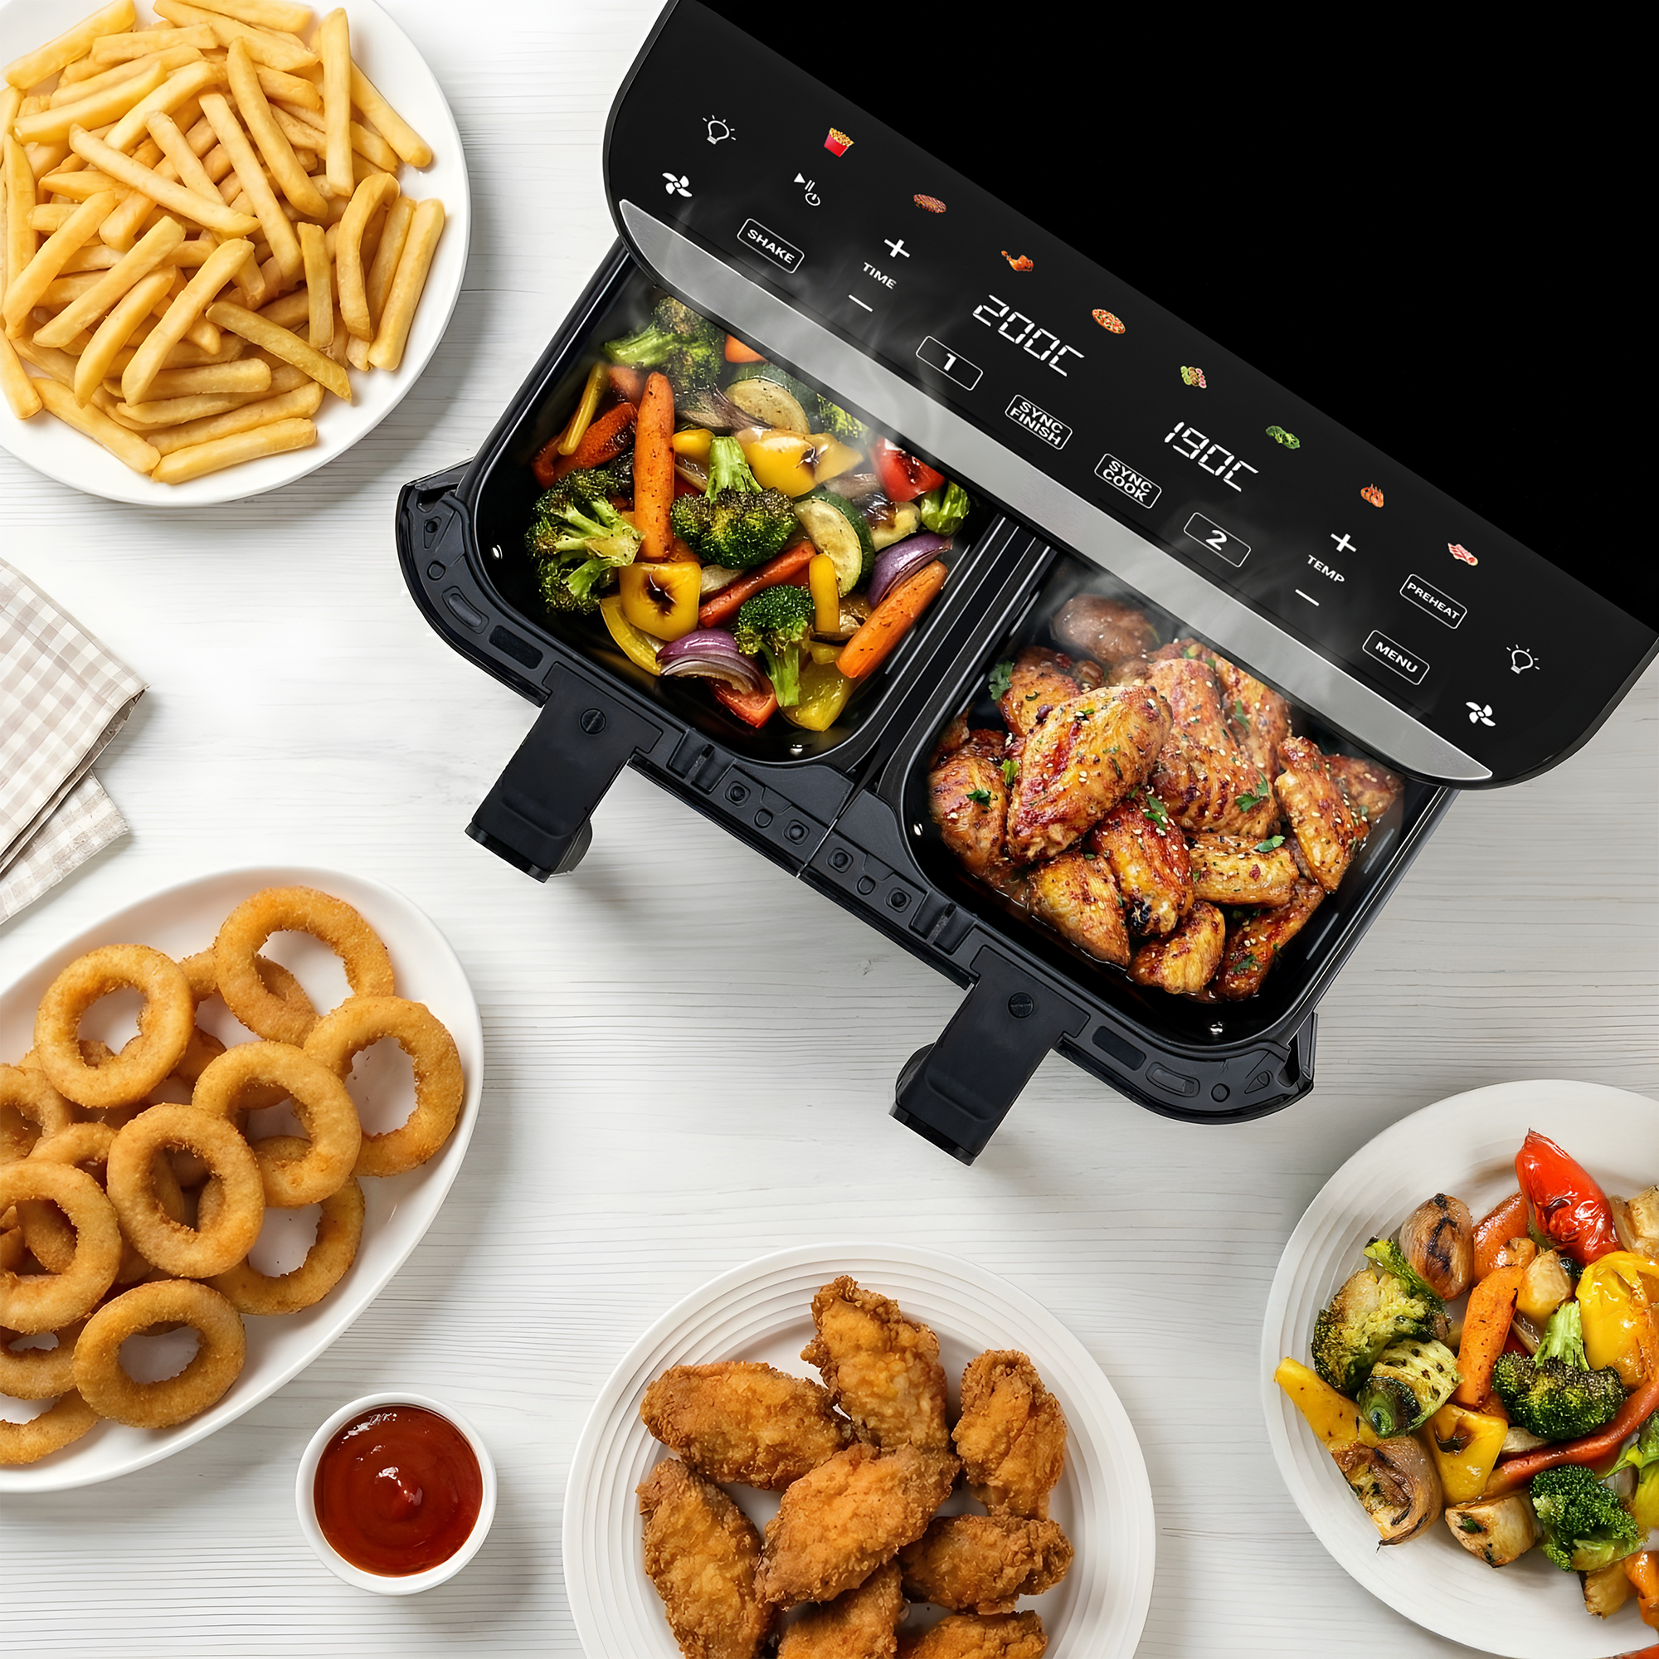
KITCHEN APPLIANCES
Air Fryers & Coffee Makers
We engineer advanced kitchen equipment designed for clean, healthy living.
Our dynamic fryer and brewing series modernize daily kitchen routines.
Dual-Zone Air Fryers: Healthy frying with up to 85% less oil, featuring synced dual baskets.
Hot Air Ovens: XL capacity ovens with rotisserie and dehydrating systems.
Premium Coffee Makers: Drip filter brewers and smart digital grind-and-brew coffee machines.

Slide 10
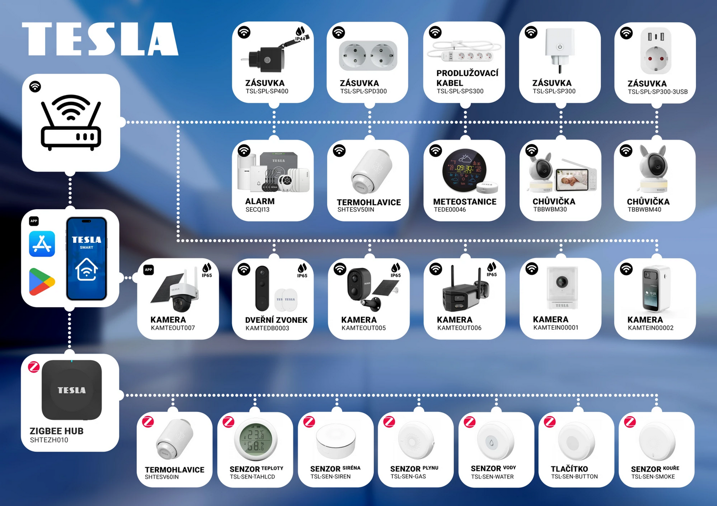
WI-FI SMART SECURITY SYSTEMS AND CAMERAS
TESLA SecureQ Series Integration
Seamless home safety managed directly from your smartphone. Fully compatible with global smart home ecosystems Tuya. Also available in TESLA Smart APP
Full Tuya IoT Ecosystem: Smoothly links with additional smart devices under a single responsive dashboard.
Mobile App Access: TESLA app available for immediate download on both Google Play and App Store.
All-In-One Protection Kits: Wireless central hub, motion sensors, door/window contacts, high-volume sirens, RFID keys, and smart cameras.

Slide 11
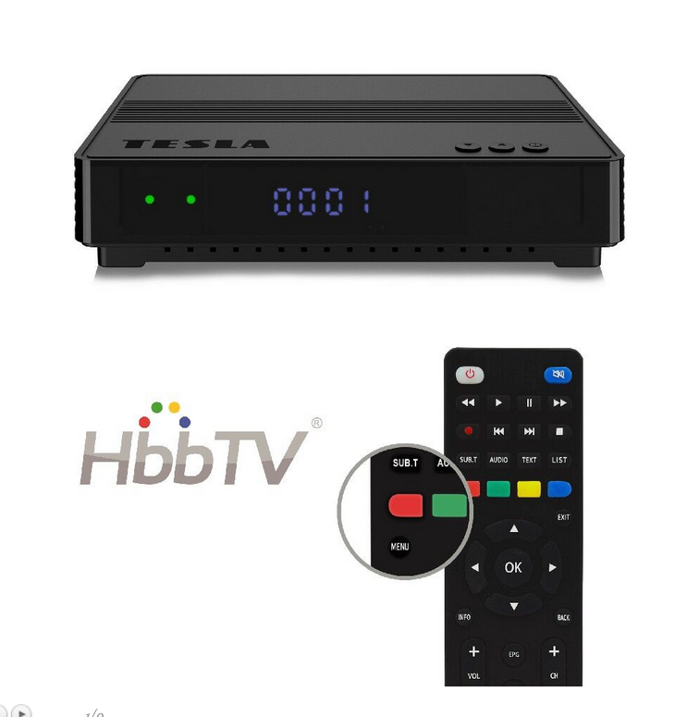
TV & DVB-T2 RECEPTION
Broadcast & Distribution Excellence
Our foundational legacy department delivers highly certified and tested digital broadcast receiver hardware.
CRA DVB-T2 Verified: Set-top boxes officially certified for flawless Czech digital broadcast transitions.
Skylink Ready: Premium satellite receivers fully certified for Czechia and Slovakia.
Interactive HbbTV: Smart hybrid broadband set-top boxes enabling red-button content and internet stream playback.
Headend Hardware: Professional transmodulators, multi-switches, high-grain antennas, and coaxial cable distribution grids.

Slide 12

THANK YOU FOR
YOUR ATTENTION
CONTACT & CORPORATE PORTALS

